Slide 1



IAS 16: PROPERTY, PLANT AND EQUIPMENT

Slide 2
PART II
Exchange of assets (Derecognition: trade-in, exchange and insurance)
Component approach
Inspection costs

Slide 3
COST MEASUREMENT: exchange of assets
(.24) Exchange of assets
Items of PPE may be acquired in exchange for non-monetary asset or a combination of non-monetary & monetary items:
Cost = fair value of asset given up, unless the fair value of the asset received is clearly more evident, OR the fair value of the asset given up can not be measured reliably
Except when:
(a) Transaction has no commercial substance, or
(b) Fair value of none of the assets (given up or received) can be measured reliably
Fair value definition

Slide 4
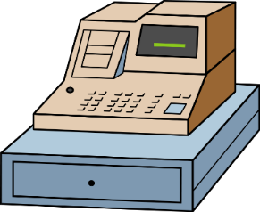
COST MEASUREMENT: exchange of assets
Exchange of assets
(.25) An entity determines whether an exchange transaction has commercial substance by considering the extent to which its future cash flows are expected to change as a result of the transaction.
If acquired item is not measured at FV
Cost = Carrying amount of asset given up
Example 9

Slide 5

RECOGNITION Components
(.9) IAS 16 does not prescribe the unit of measure for recognition, use judgement and aggregate individually insignificant items.
Entity thus evaluates all PPE costs at the time they are incurred.
PPE cost includes:
Initial costs incurred to acquire or construct an item of PPE; and
Subsequent cost to add to, replace part of, or service item of PPE. (NB refer to par.12)

Slide 6
RECOGNITION Components
(.44) An entity must allocate the amount initially recognised as a PPE item to the significant components of the item.
(.43) Significant components are depreciated separately
Significant components are usually a part of the PPE item with a significant cost in relation to the PPE item as a whole, or
Which useful life differs significantly from the rest of the PPE item.

Slide 7
MEASUREMENT AFTER INITIAL RECOGNITION: Components
(.43) Depreciation
Each item of PPE with cost that is significant in relation to total cost of the item shall be depreciated separately
Components with same useful life and depreciation method – can be grouped together for calculation of depreciation
Rest of components that is not individually significant – grouped together and depreciated
NB: Components are depreciated separately but are reported at an asset level to the external users. They are not reported separately in the AFS.
This means that Seats + Engine = Bus, and Bus is what is reported on in the financial statements.

Slide 8
Example of components
Plant originally recorded at cost: R950 000
The plant item are made up by the following significant components:
Construction/Structure (pipes, stand, etc.)
Machines
Computer equipment
The components of the asset with significant costs will be depreciated separately based on each of the components’ useful life (see par. 43).
The depreciable amount of each component much be written of separately over the useful life of each component
R500 000
R400 000
R50 000

Slide 9
RECOGNITION other matters
(.11) PPE acquired for safety or environmental reasons, although not directly increasing future econ benefits, enables an entity to derive future economic benefits from related assets in excess of what could be derived had those items not been acquired. Therefore:
Recognise as an asset
Review carrying amount i.t.o IAS 36 for impairment (FA 278)

Slide 10
RECOGNITION Subsequent costs
(.12) Day-to-day servicing costs (day-to-day repair work and maintenance) NOT part of PPE
= profit & loss (Dr Expenses (P/L))
E.g. replace button on computer / anti-virus program (only ensures that asset continues to work as originally intended, does not improve its performance).
(.13) REPLACING OF PARTS
Parts requiring replacement at regular intervals:
Capitalise costs of replacement (recognize as PPE) if recognition criteria of PPE is met
Derecognize the remaining carrying amount of the parts replaced

Slide 11
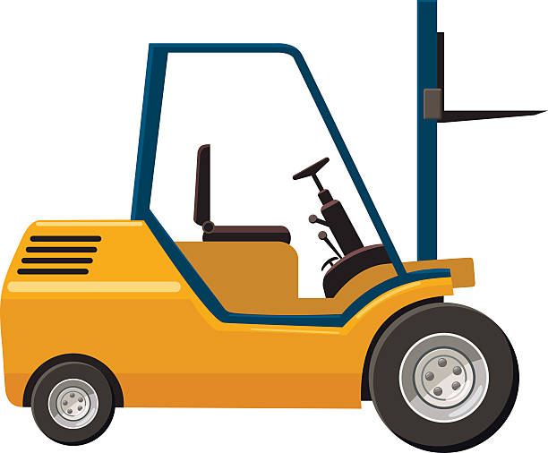
DERECOGNITION: Components
(.70) If cost to replace part of a PPE item was recognised as part of the cost price, i.t.o par 7,
then the part that is being replaced should be derecognised, even if it was not initially identified as a significant component
The replacement cost can be used as an estimate of the initial cost of the part that is being replaced, if it is not practical to determine the carrying value of the item being replaced
Example 1 and 2

Slide 12
RECOGNITION: SUBSEQUENT COSTS Inspection costs
(.14) MAJOR INSPECTIONS
A condition to continue the use of an item of PPE may be that major inspections must be performed, regardless of whether components of the item are replaced:
recognise cost of the inspection as part of the PPE item when inspection is performed (separate component), and
if recognition criteria is met
Thus, capitalise inspection costs
costs depreciated over estimated period until next inspection

Slide 13
RECOGNITION: SUBSEQUENT COSTS Inspection costs
(.14) MAJOR INSPECTIONS
derecognise any remaining carrying amount of the previous inspection, regardless of whether it was identified in the transaction in which the item was acquired or constructed.
If necessary, the estimated cost of a future similar inspection may be used as an indication of what the cost of the existing inspection component was when the item was acquired or constructed.

